Slide 1
Examining Bluegill (Lepomis macrochirus) growth in two MN reservoirs
Ben Olson, Patrick Little

Slide 2
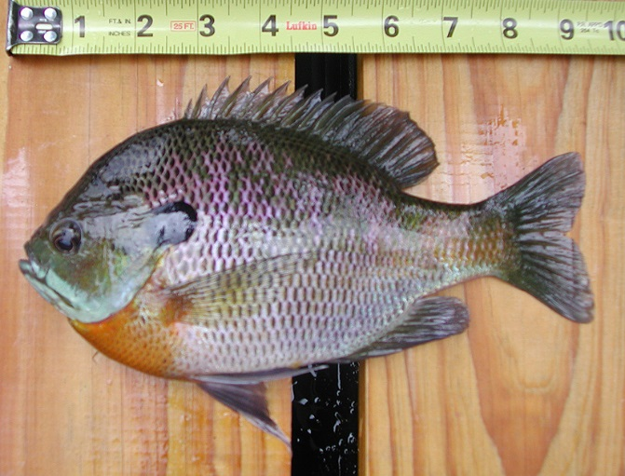
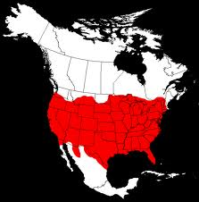
Bluegill (Lepomis Macrochirus)
Family- Centrarchidae
Distribution
Nearly the entire lower 48
Reproduction
Late Spring-Early Summer spawners
Ecology
Live in shoals amongst macrophytes in the warmer, shallower water of a lake
Wide range of tolerance
Forage on macroinvertebrates and small fish and amphibians
http://upload.wikimedia.org/wikipedia/commons/c/c8/Bluegill_sc.jpg
http://www.roughfish.com/bluegill

Slide 3
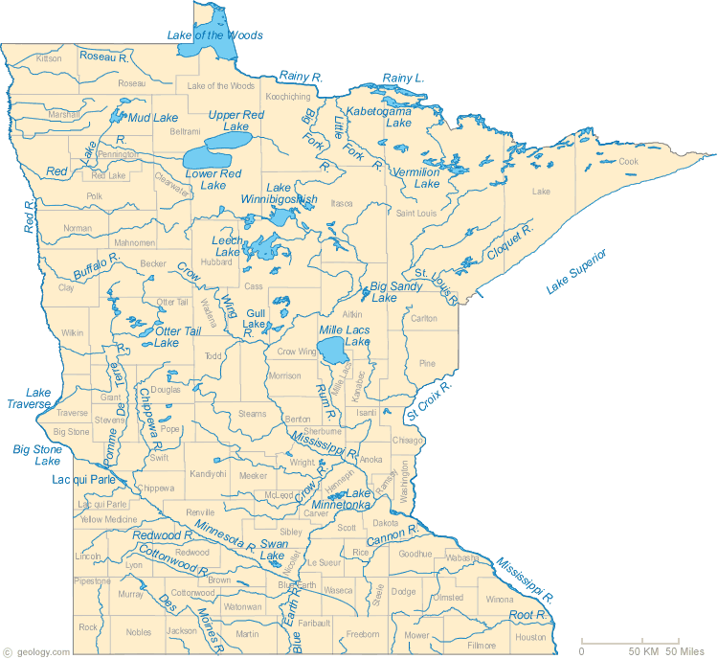
Introduction
Sampled two Minnesota reservoirs
Rice Lake, Brainerd area
Fish Lake, Duluth area
Both lakes are similar in trophic level status and are categorized as slightly eutrophic
http://geology.com/state-map/maps/minnesota-rivers-map.gif

Slide 4
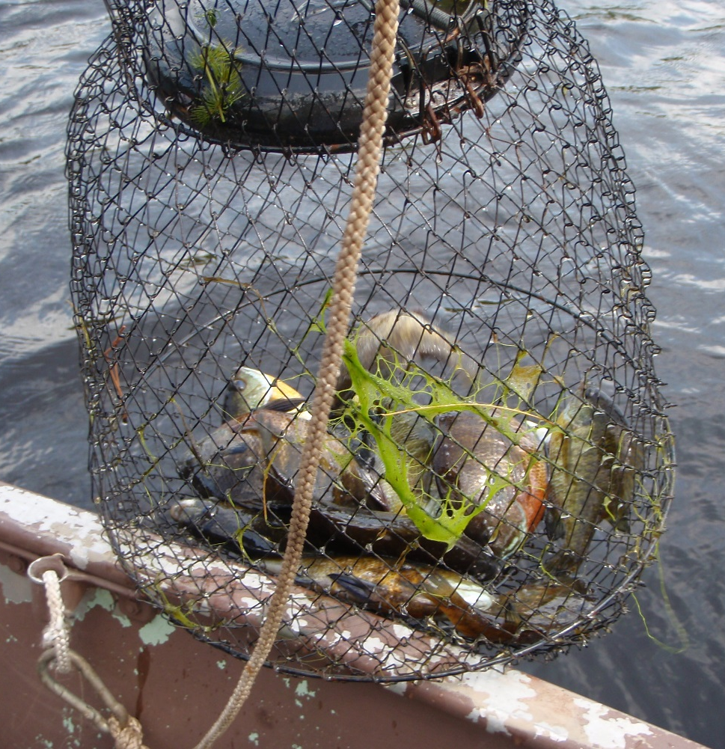
Introduction
Our goal was to find out if there was a difference in growth rates or growth patterns in B.G. between Rice lake and Fish lake.
Our hypothesis was that there is a difference in growth rates or growth patterns in B.G. between both lakes.
We will discussion several reasons why there could be a difference in growth rates and growth patterns based on previous studies done on B.G. in Minnesota.

Slide 5
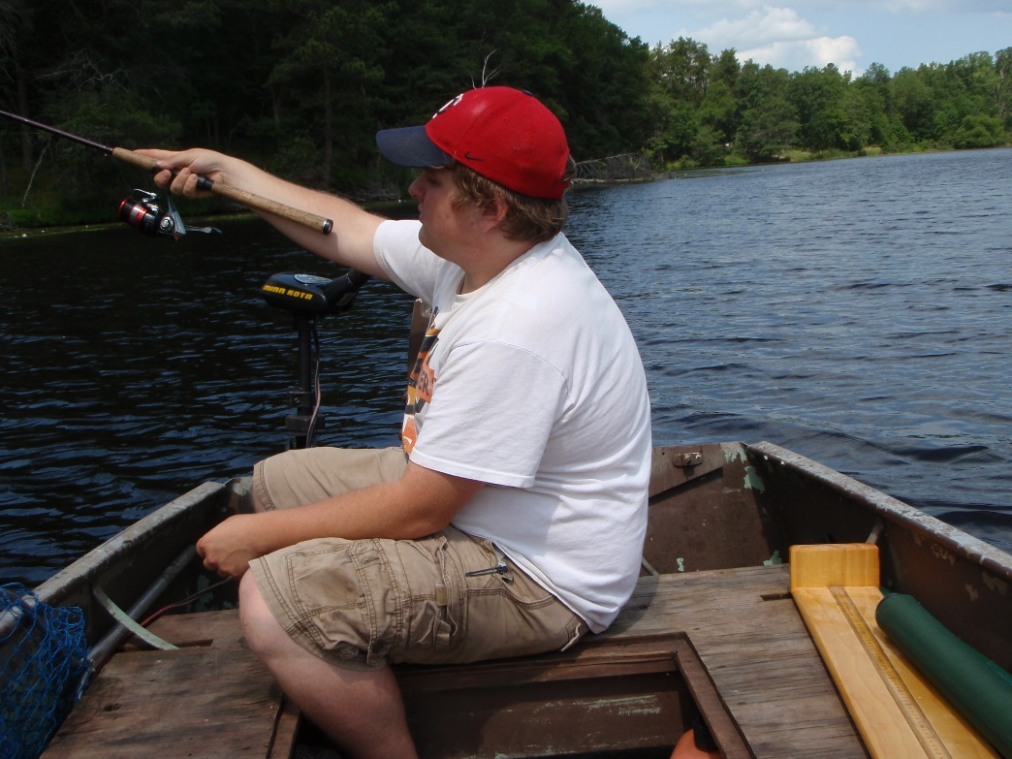
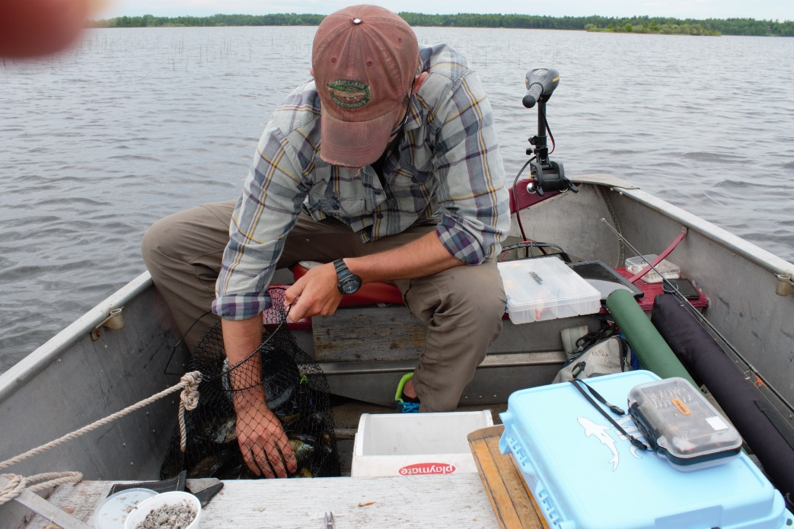
Methods: collection
Field collection
50 fish from Fish lake and 25 fish from Rice lake using conventional rod and Reel
Near shore, close proximity to spawning sites

Slide 6
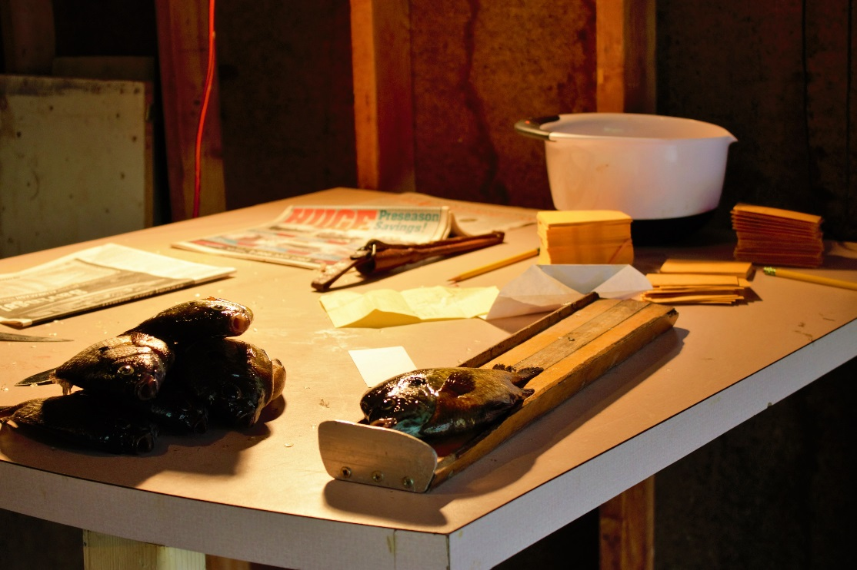
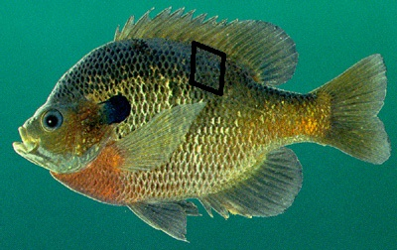
Methods: collection
Aging structures
Collected scales from the dorsal side of the lateral line where the end of the pectoral fin meets the lateral line.
Total Length
Used a bump board to measure the total length of each fish in mm.
Date and Location
What lake and date of collection
http://www.outdooralabama.com/sites/default/files//fishing/images/Bluegill400.jpg

Slide 7
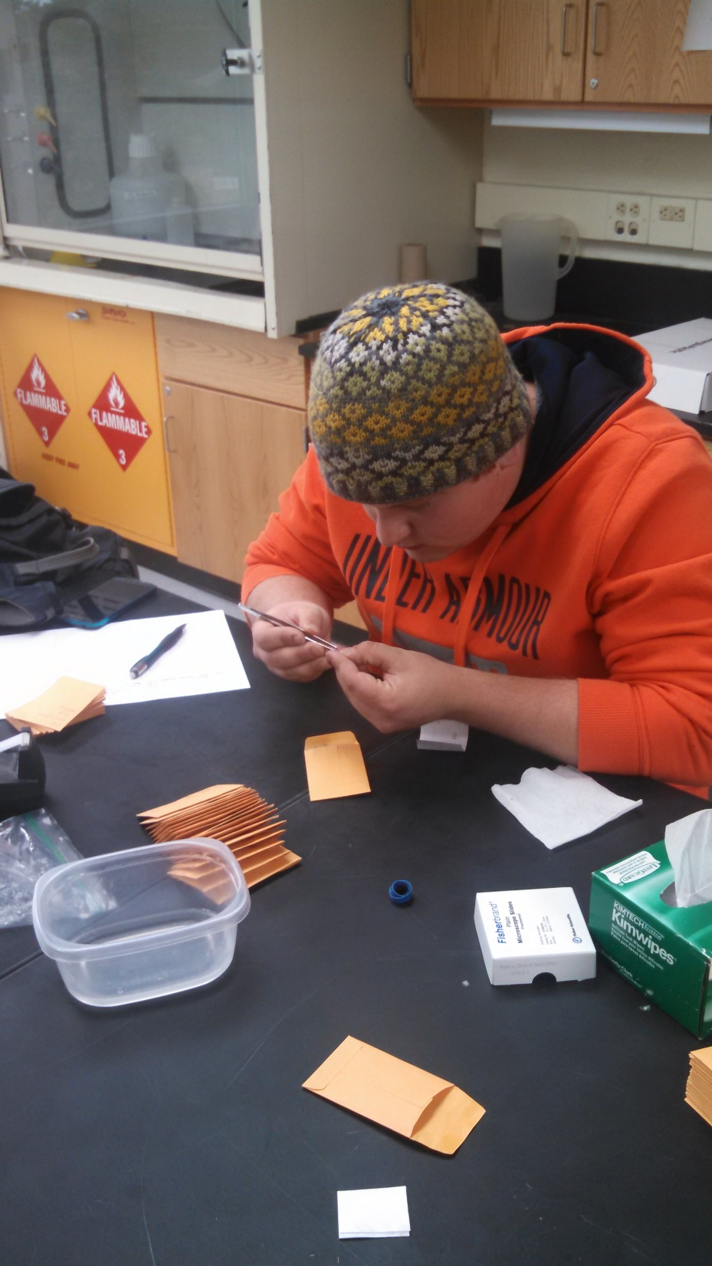
Methods: scale preparation
Four scales per slide
Cleaned the scales of dermal tissue
Marked each slide with a fish ID #

Slide 8
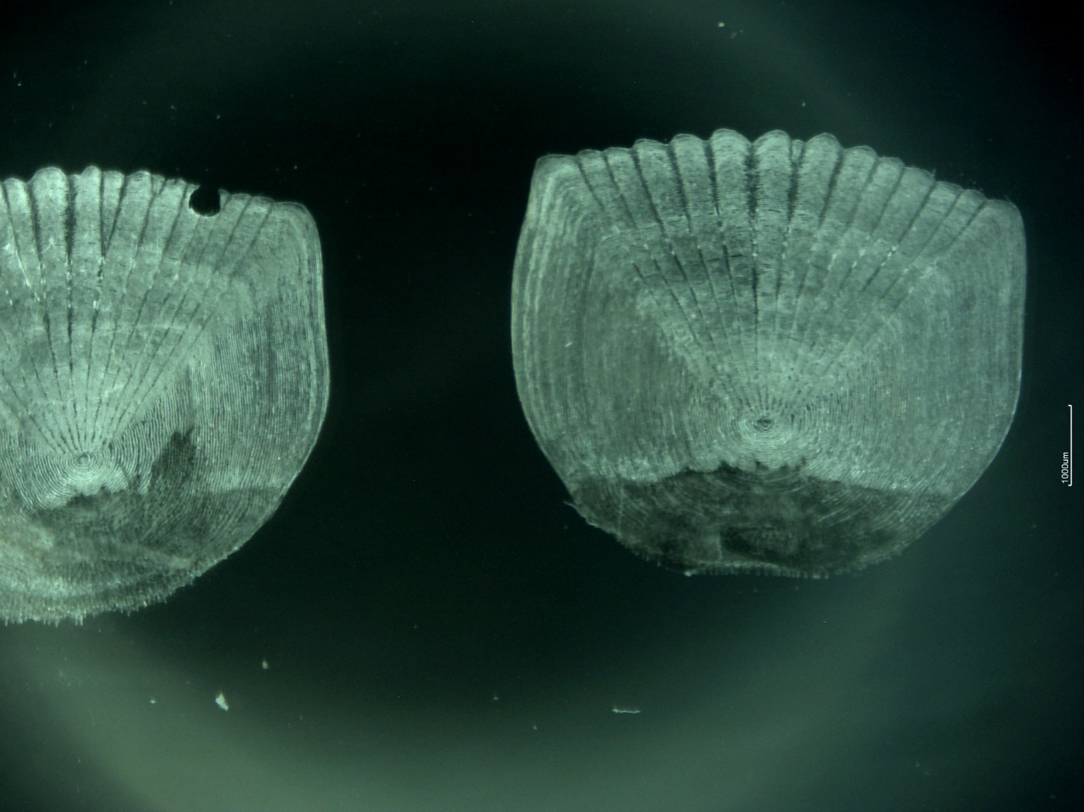
Methods: scale aging
Used moticam to take pictures of each scale under a microscope and age each fish based on number of annuli.

Slide 9
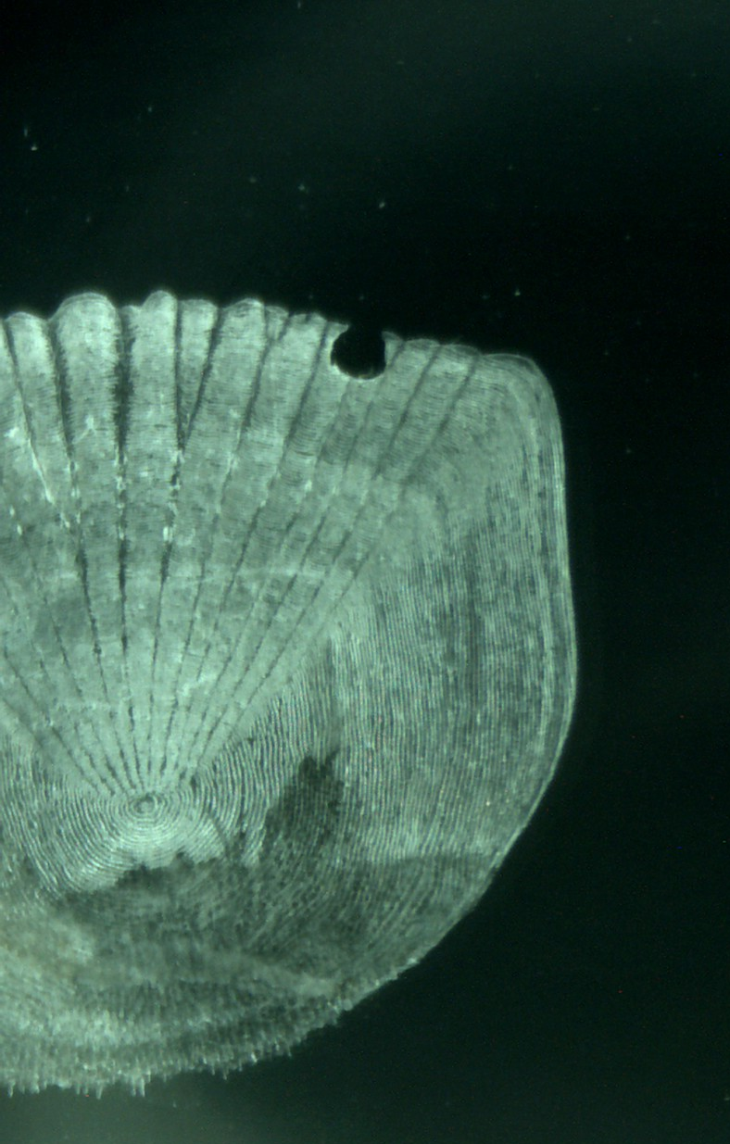
Methods: back-calculation
Image J software
Measured total scale radius from the focus to the outer edge
Measured the radius from the focus to each annuli

Slide 10
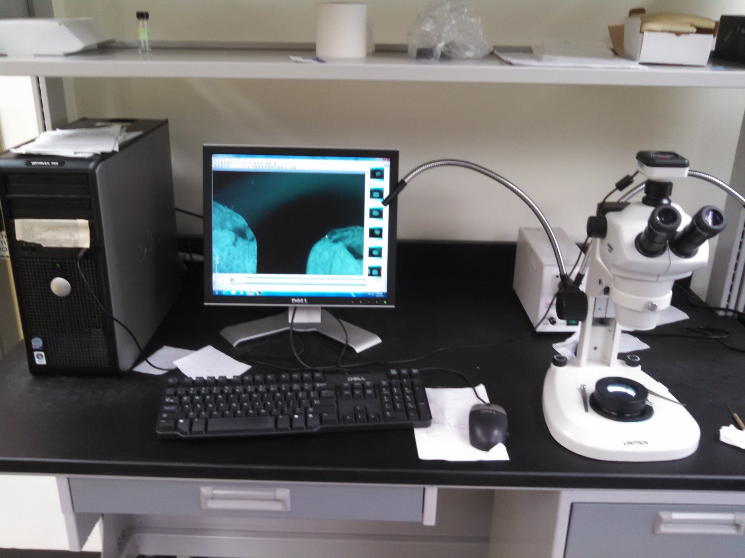
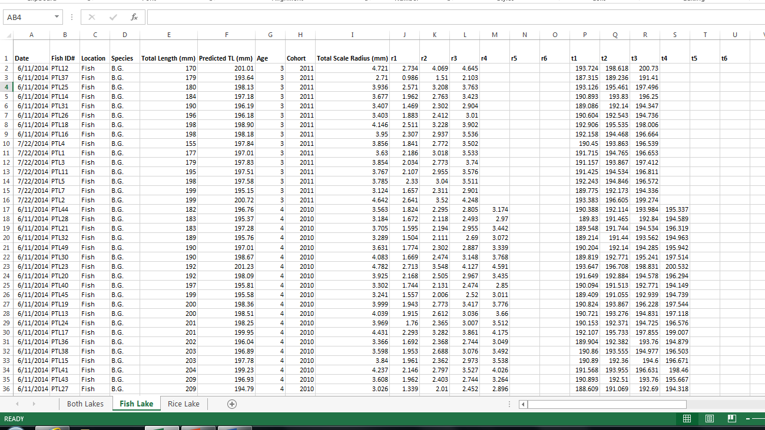
Methods: data analysis
Microsoft excel
Entered all the data into spreadsheets
Made figures and tables to graphically show growth rates and growth patterns in our data.

Slide 11
Results
We will compare
Average length at age
Length frequency distribution
Scale radius back-calculations
Total scale radius vs. total length
Analyzing these four areas will help us compare growth rates and growth patterns

Slide 12
Results
2012
2011
2010
2011
2010
2009
Rice Lake has very defined cohorts
2011 cohort has the most fish (3 year olds)
Fish Lake cohorts are harder to distinguish
2010 cohort has the most fish (4 year olds)

Slide 13
results
Rice lake B.G. are growing more on average per year.
Fish lake B.G. sampled were larger
No 5 year old fish sampled in Rice lake
Rice lake has a higher growth rate

Slide 14
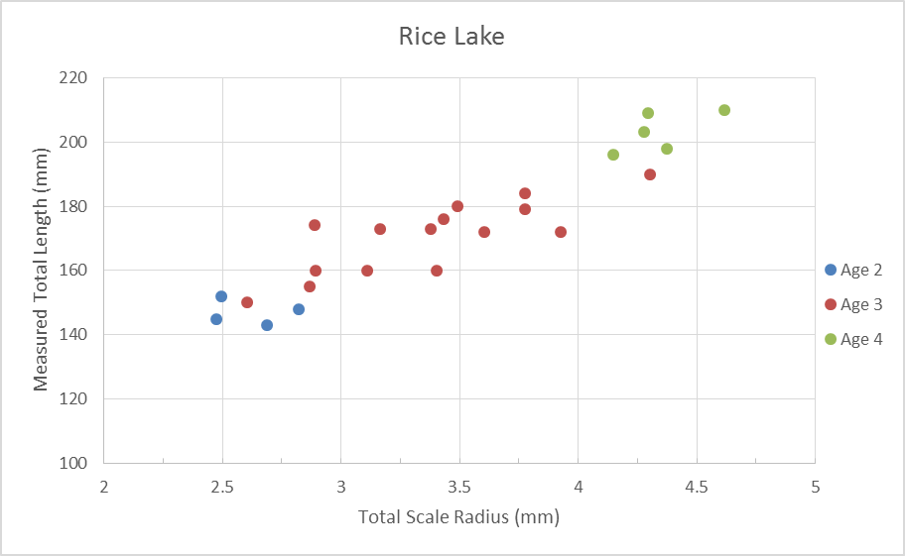
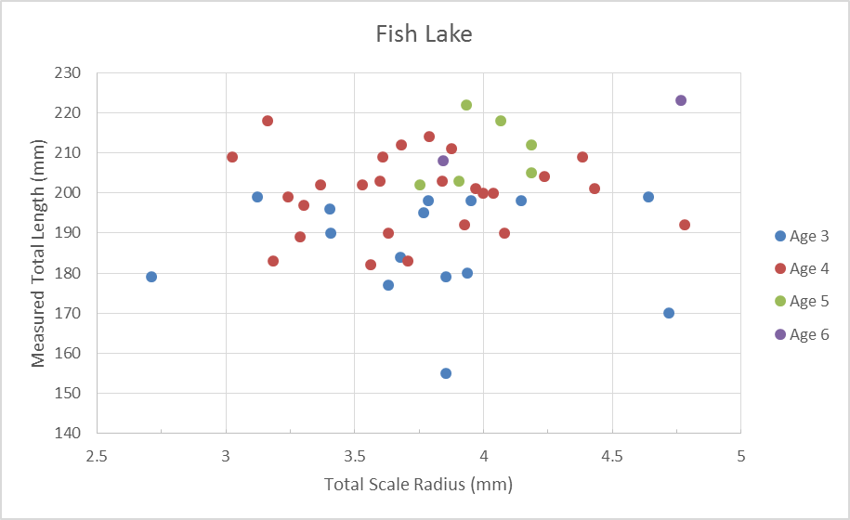
Results

Slide 15
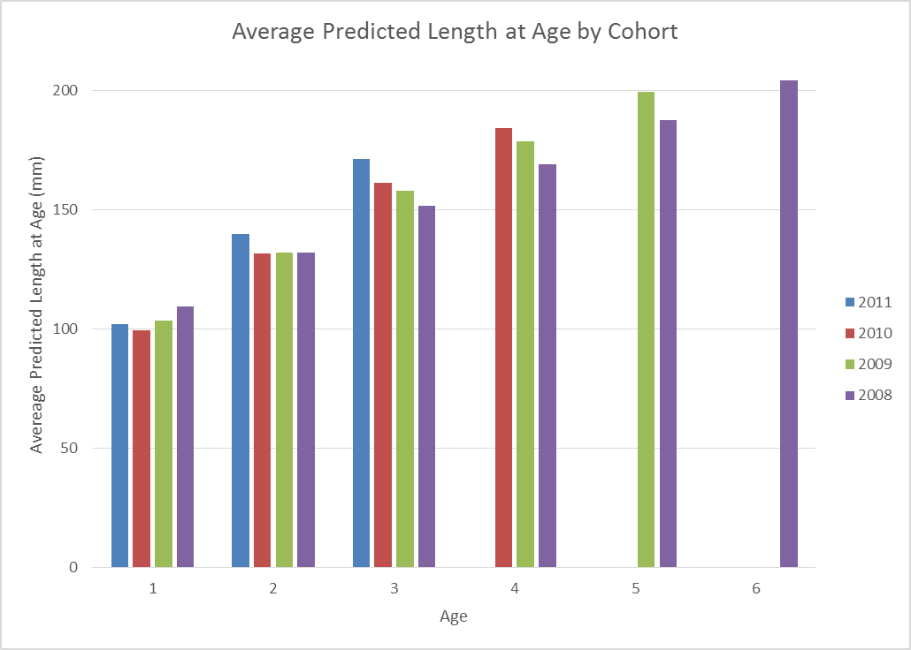
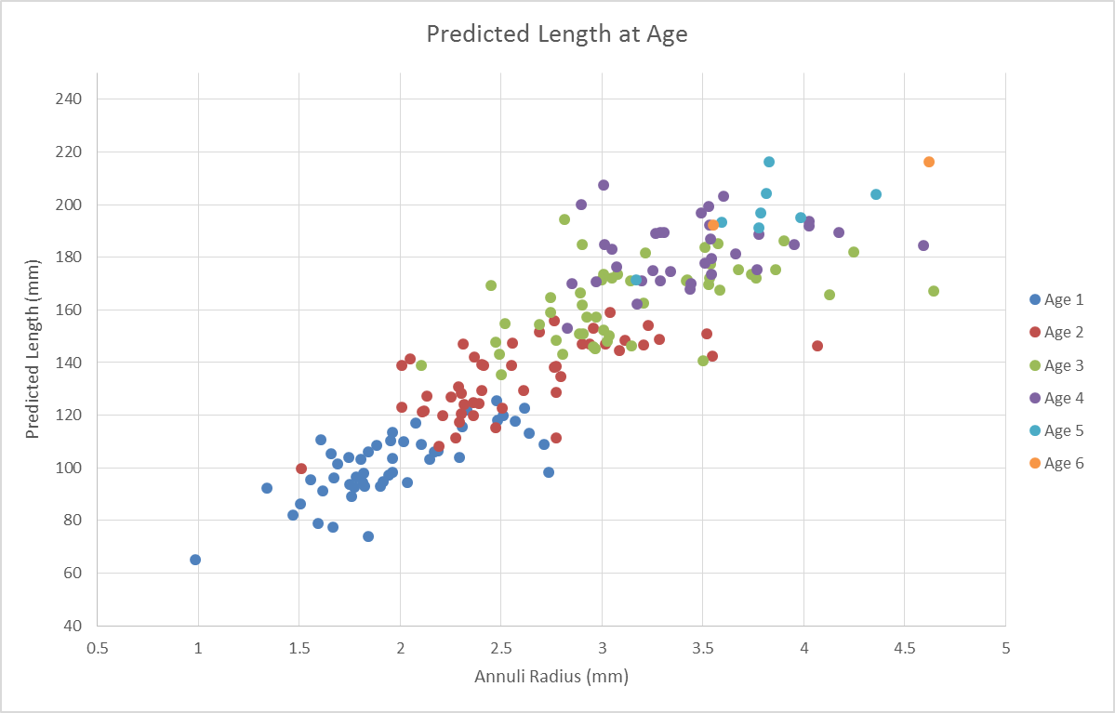
Results
Back–calculated length at age for Fish Lake

Slide 16
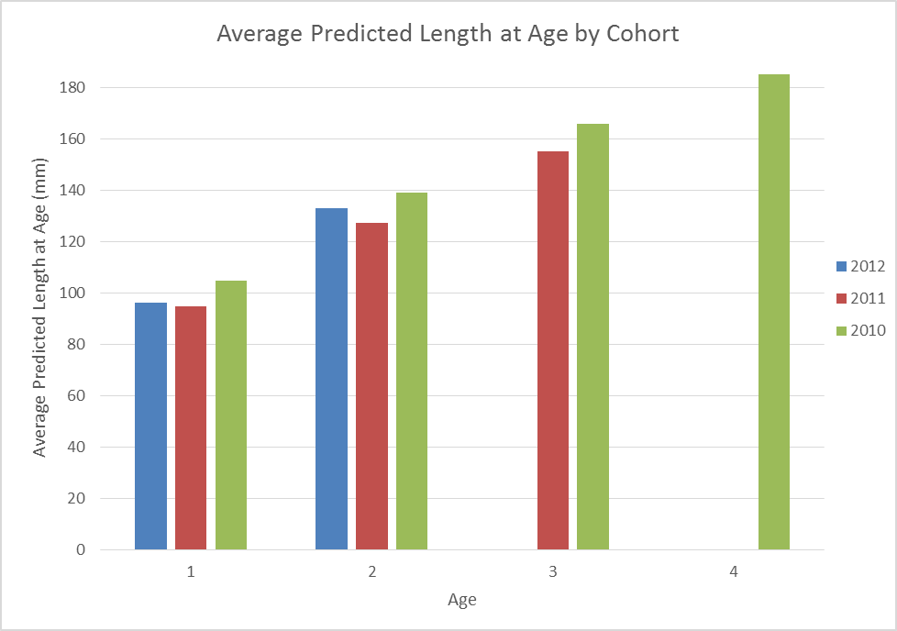
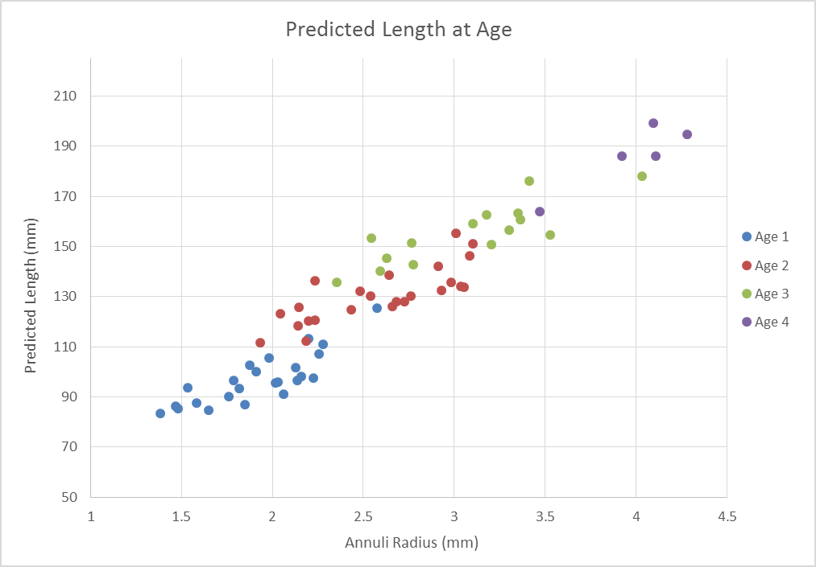
Results
Back–calculated length at age for Rice Lake

Slide 17
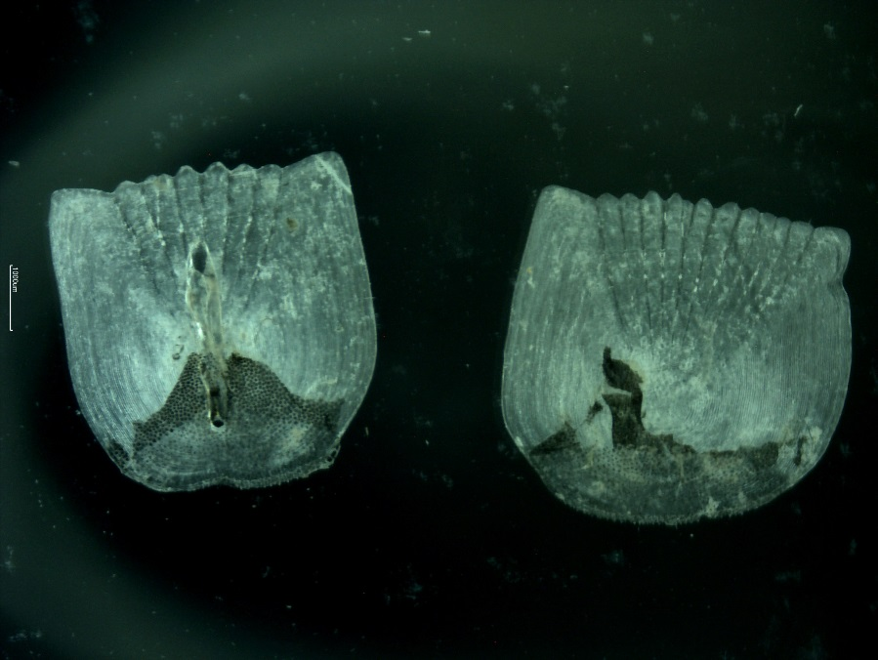
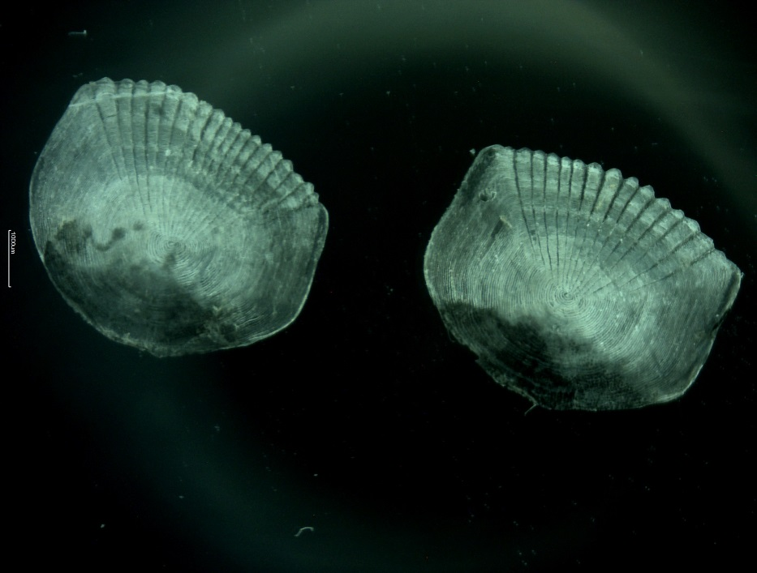
Results
R Square 0.867298082
R Square 0.014867363
Fish: 1.4% of variation in total length explained by total scale radius
Rice: 86.7% of variation in total length explained by total scale radius
Date | Fish ID# | Location | Species | Total Length (mm) | Predicted TL (mm) | Age | Cohort | Total Scale Radius (mm)
6/11/2014 | PTL12 | Fish | B.G. | 170 | 201.01 | 3 | 2011 | 4.721
6/11/2014 | PTL37 | Fish | B.G. | 179 | 193.64 | 3 | 2011 | 2.71

Slide 18
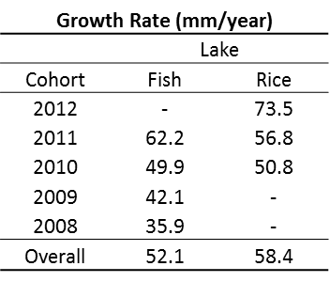
Results
Growth Rates
Shoreline Development

Slide 19
Discussion
Hypothesis: Growth patterns and rates are different from each lake
After looking at our results, we have accepted our original hypothesis that there is a difference in growth patterns and growth rates between each lake.
We will hypothesize based on previous research done on B.G. on three possible explanation for differences in growth rates and patterns.
Trophic status index
Density
Temperature
Shoreline Development

Slide 20
Discussion: Trophic Status Index
Trophic Status Index (TSI): Level of growth or productivity of a lake as measured by phosphorus content, algae abundance, and secchi depth. Range is from 20-80, 20 being very clear and unproductive, and 80 being very green and productive.
Rice Lake: TSI=52
Fish Lake: TSI=50
Both are considered moderately green or Eutrophic
Rice lake is slightly more productive then Fish lake.
This could also account for higher growth rates in Rice lake

Slide 21
Discussion: Density
Rice Lake 2007 survey: 11.22 B.G. per trap net
Fish Lake 2010 survey: 13.47 B.G. per trap net
Fish Lake has a higher density of B.G. surveyed then Rice Lake
Intraspecific competition for habitat and resources could be occurring more in Fish lake then in Rice Lake, which could account for a lower growth rate.

Slide 22
Discussion: Temperature
Temperature determines growth rate
Growing season
Determined by ice-out and ice-in
Duluth lakes average ice in one week earlier than Brainerd lakes, and ice-out 2-3 weeks later
Air temperature in Brainerd also averages higher than Duluth during the growing season

Slide 23
Discussion: Shoreline Development

Slide 24
Discussion: Other factors
Water Clarity
Vegetation Density
Fish Size

Slide 25
Conclusion:
Our research tells us that B.G. in Rice lake are generally smaller in size but grow at a faster rate and exceed the average length at age once they have reached four years old as compared to B.G. in Fish lake.
This difference in growth could be attributed to Rice Lake’s higher productivity, earlier ice-out, and possible decreased density-dependent intraspecific competition
In order to get a more accurate picture of growth rates and growth patterns it would be beneficial to collect more younger fish in Fish lake.
The fish we collected in Fish Lake were mostly large parental males.

Slide 26
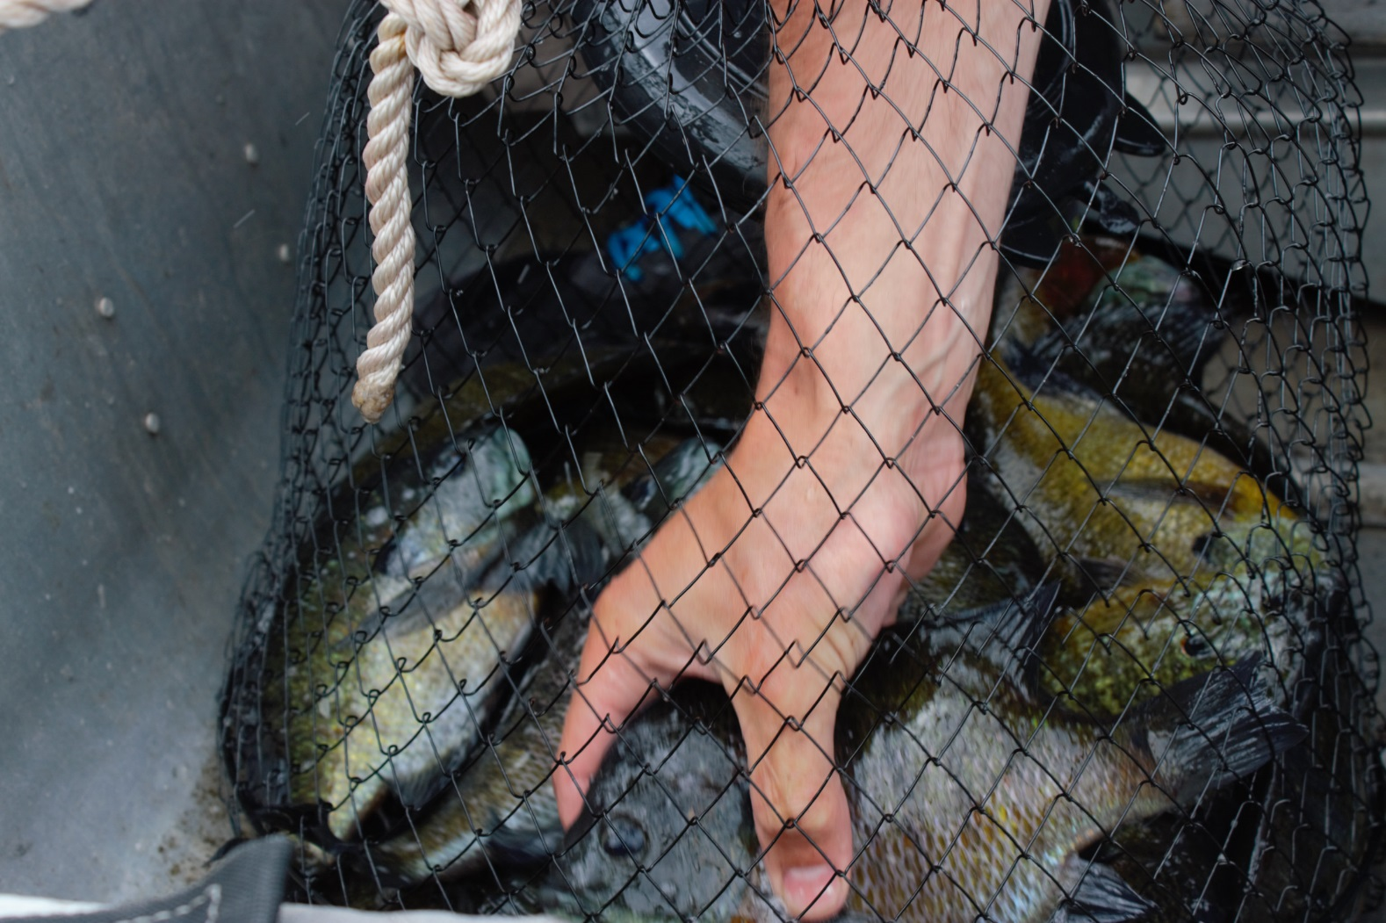
Questions?

